Slide 1
Introduction to Computer Classification of Computers

Slide 2
Classification of Computers
Computers are classified according to their data processing speed, amount of data that they can hold and price
Depending upon their speed and memory size, computers are classified into four groups:
Super computer
Mainframe computer
Mini computer
Microcomputer

Slide 3
Super Computer
Super computer is the most powerful and fastest, and also very expensive.
Process large amount of data
Solve the complicated scientific problems
It has large number of processors connected parallel
Thousands of users can be connected at the same time

Slide 4
Uses of Super Computer
Weather forecasting
Nuclear energy research
Aircraft design
Automotive design
Online banking
To control industrial units

Slide 5
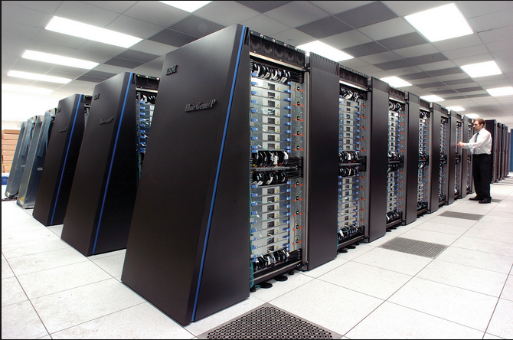
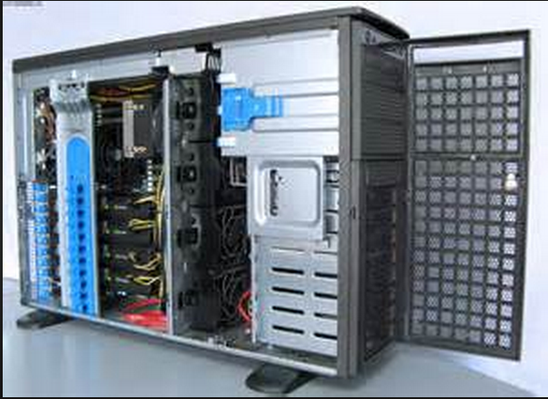
Super Computer
http://mymixpedia.com/mix-pictures/electronics/supercomputer/
https://en.wikipedia.org/wiki/File:IBM_Blue_Gene_P_supercomputer.jpg

Slide 6
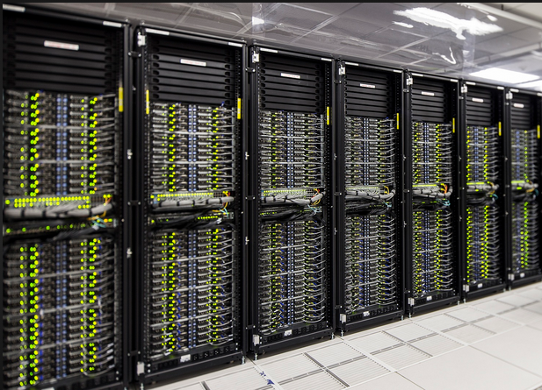
Super Computer
http://goparallel.sourceforge.net/worlds-largest-commercial-supercomputer-underway/

Slide 7
Mainframe Computer
large scale computers
Supercomputers are large than mainframe
Very expensive
Need a clean room with air-conditioner
Handle the input and output requirements of several thousand of users
Users often access the mainframe with terminals or personal computers
IBM is the major manufacturer of mainframe computers

Slide 8
Types of Mainframe Computer
Dumb Terminal
Does not have CPU and storage devices
Consists of monitor and keyboard
Intelligent Terminal
Has Processor
Does not have its own storage
Personal computers used as intelligent terminal

Slide 9
Uses of Mainframe Computer
As Servers
In large organizations such as Banks, Airlines and universities

Slide 10
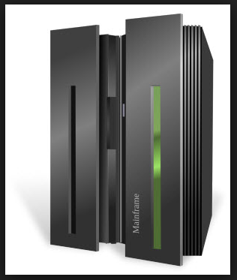
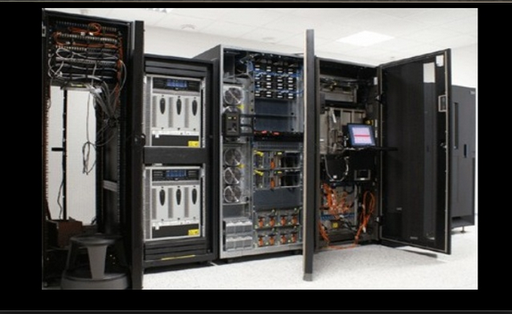
Mainframe Computer
http://www.on-select.com/gal/m/mainframe-computer-images/
http://www.slideshare.net

Slide 11
Mini Computer
Smaller in size
Lower processing speed
Lower cost than mainframe
Capabilities are between mainframe and personal computer
Also called as midrange computers
Designed for a single user but most are designed to handle multiple terminals

Slide 12
Uses of Mini Computer
Business
Education
Government departments
Used as servers in network environment

Slide 13
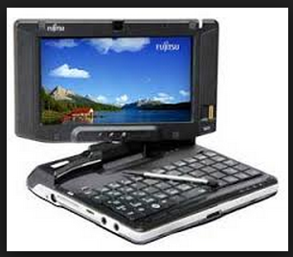
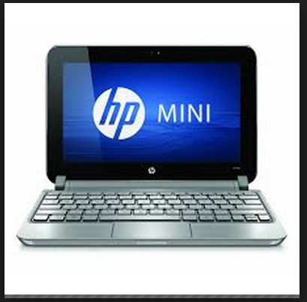
Mini Computer
http://ictlisfun.blogspot.com/2011/07/minicomputer.html
http://www.bootic.com/hp/electronics/computers/laptops/netbooks/hp-mini-210-2170nr

Slide 14
Micro Computer
Also known as personal computers
Small in size and cost
Available in two models
Desktop PCs
Tower PCs

Slide 15
Categories of Micro Computer
Desktop and Tower Models
Notebook or Laptop Computers
Network Computers
Handheld Personal Computers

Slide 16
Desktop and Tower Models
A computer designed to fit comfortably on top of a desk, typically with the monitor sitting on top of the computer.
Desktop model computers are broad and low,
tower model computers are narrow and tall.
Desktop models designed to be very small are sometimes referred to as slim line models.

Slide 17
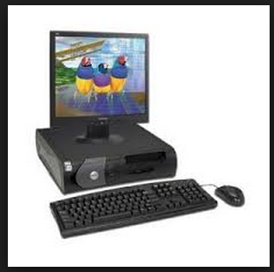
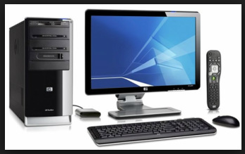
Desktop and Tower Models
http://palaceofcomputers.weebly.com/types.html
http://www.nairaland.com/2436378/hp-dell-desktop-tower-computers

Slide 18
Notebook or Laptop Computers
A small, portable computer -- small enough that it can sit on your lap. Nowadays, laptop computers are more frequently called notebook.
Operated on a special battery
Portable
Memory and storage capacity is almost equivalent to the PC or desktop computer
Access to computing capability at all times and places on working area .Access to their files-even very large files-at all times
More expensive than desktop computer

Slide 19
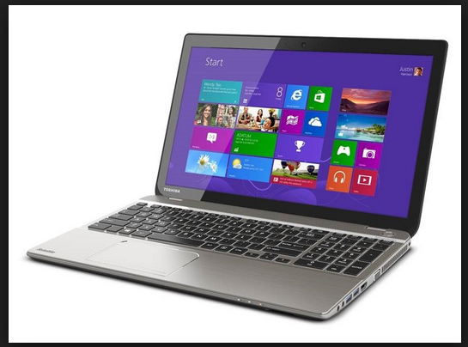
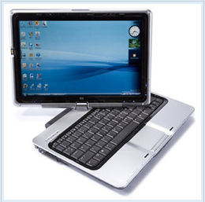
Notebook or Laptop Computers
http://palaceofcomputers.weebly.com/types.html
http://betanews.com/2014/01/06/toshiba-unveils-first-ever-4k-laptops-but-do-consumers-actually-need-them/

Slide 20
Workstation
Special single user computer
Processing speed equivalent to minicomputer or main frame computer
Expensive and powerful computer
Advanced processor, more RAM and storage capacity
Used as servers on computer networks and web servers as well
Scientists, engineers, architects and graphic designer mostly use these computers

Slide 21
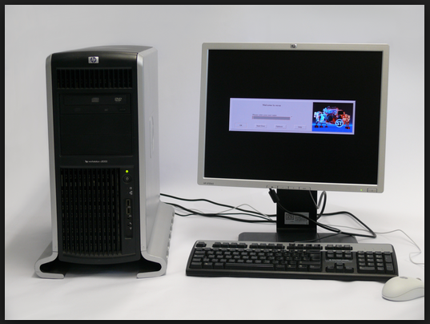
Workstation
https://en.wikipedia.org/wiki/Workstation#/media/File:HP-HP9000-C8000-Workstation_33.jpg

Slide 22
Network Computer
Version of personal computer having less processing power, memory and storage
Specially designed as terminals for network environment
Designed for network, Internet or Intranet for data entry or to access data on the network
Depend upon the network’s server for data storage and to use software and to perform some processing tasks
Cheaper to Purchase

Slide 23
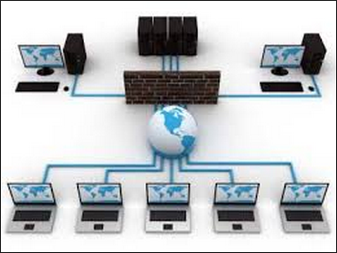
Network Computer
http://villagetech.co/seo-library/computer-network/

Slide 24
Handheld Computer
Referred to as Palmtop Computers
Also called mini-notebook computers
Can fit in one hand that’s why called handheld
Example of handheld computers are:
Personal Digital Assistance
Cellular telephones
H/PC Pro devices

Slide 25
Handheld Computer
http://www.diytrade.com/china/pd/9797953/Industrial_handheld_PDA_terminal_with_barcode_laser_scanning_GPRS_Bluetooth_WIFI.html

Slide 26
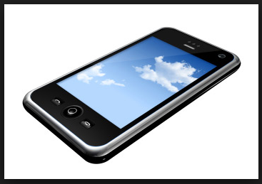
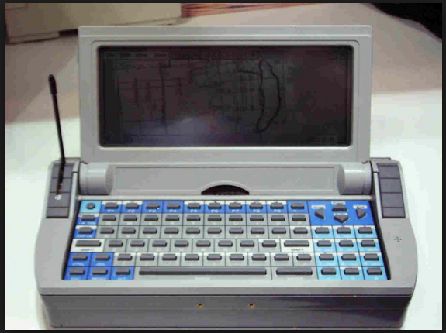
Handheld Computer
http://www.pocketpcfaq.com/wce/21/HPCPropics.htm
http://www.ezwide.com/search_img.php?p=1&k=cellular+telephones&k_se=992

